Slide 1
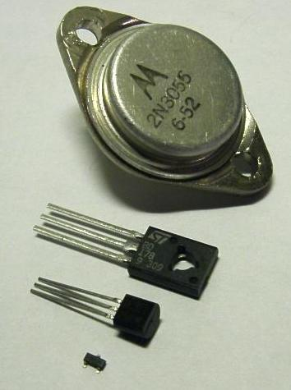
TRANSISTOR
A transistor is a semiconductor device used to amplify or switch electronic signals and electrical power. It is composed of semiconductor material usually with at least three terminals for connection to an external circuit. A voltage or current applied to one pair of the transistor's terminals controls the current through another pair of terminals. Because the controlled (output) power can be higher than the controlling (input) power, a transistor can amplify a signal. Today, some transistors are packaged individually, but many more are found embedded in integrated circuits.
The transistor is the fundamental building block of modern electronic devices, and is ubiquitous in modern electronic systems. Julius Edgar Lilienfeld patented a field-effect transistor in 1926^{[1]} but it was not possible to actually construct a working device at that time.

Slide 2
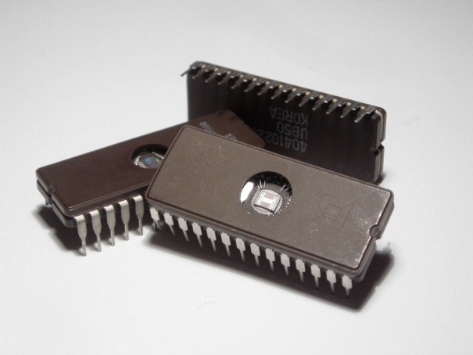
Integrated circuit
An integrated circuit or monolithic integrated circuit (also referred to as an IC, a chip, or a microchip) is a set of electronic circuits on one small flat piece (or "chip") of semiconductor material that is normally silicon. The integration of large numbers of tiny transistors into a small chip results in circuits that are orders of magnitude smaller, cheaper, and faster than those constructed of discrete electronic components. The IC's mass production capability, reliability and building-block approach to circuit design has ensured the rapid adoption of standardized ICs in place of designs using discrete transistors. ICs are now used in virtually all electronic equipment and have revolutionized the world of electronics. Computers, mobile phones, and other digital home appliances are now inextricable parts of the structure of modern societies, made possible by the small size and low cost of ICs.

Slide 3
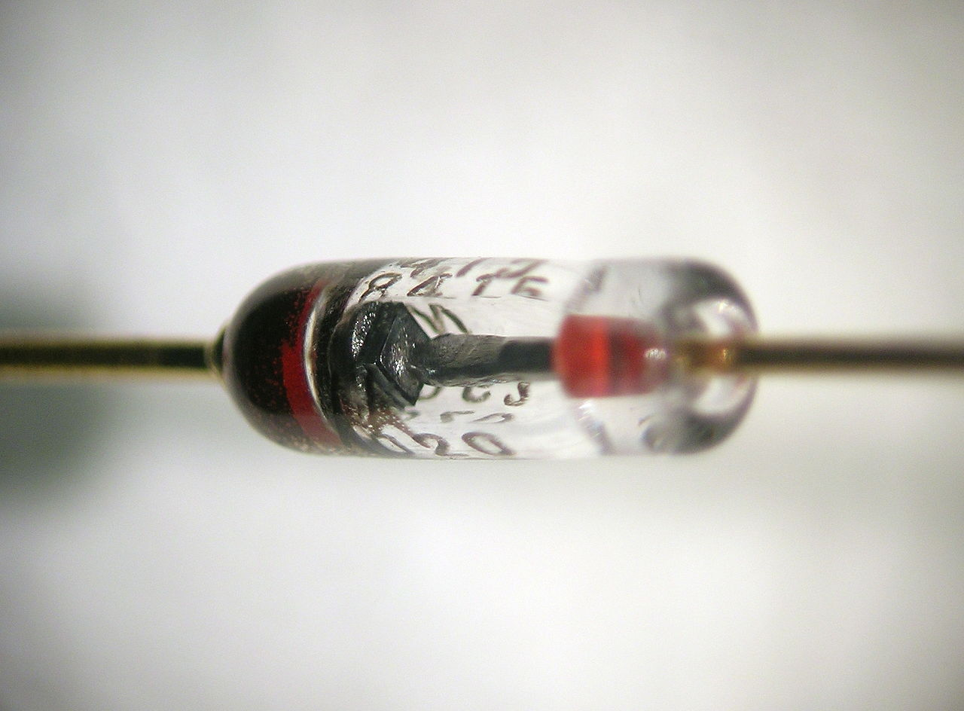
diode
The most common function of a diode is to allow an electric current to pass in one direction (called the diode's forwarddirection), while blocking it in the opposite direction (the reverse direction). As such, the diode can be viewed as an electronic version of a check valve. This unidirectional behavior is called rectification, and is used to convert alternating current (ac) to direct current (dc). Forms of rectifiers, diodes can be used for such tasks as extracting modulation from radio signals in radio receivers.
Close-up view of a silicon diode. The anode is at the right side; the cathode is at the left side (where it is marked with a black band). The square silicon crystal can be seen between the two leads.

